Slide 1
Apixaban in stroke
Taher Entezari-Maleki, Pharm.D., PhD
Associated Professor of Clinical Pharmacy

Slide 2
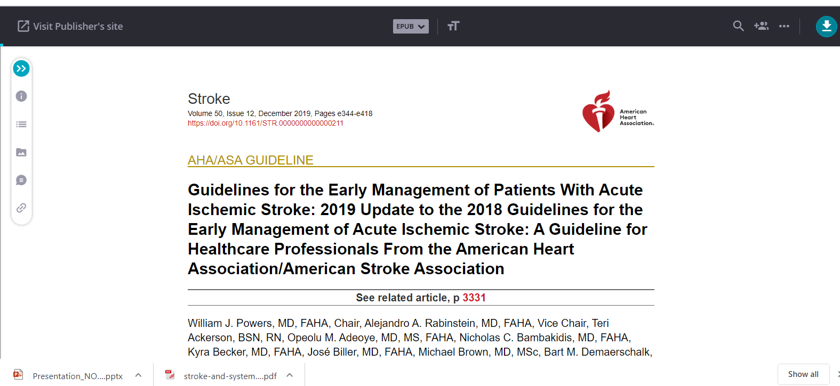

Slide 3
The American College of Cardiology (ACC)/AHA Class of Recommendations (COR) IIb and Level of Evidence (LOE) C-limited data

Slide 4
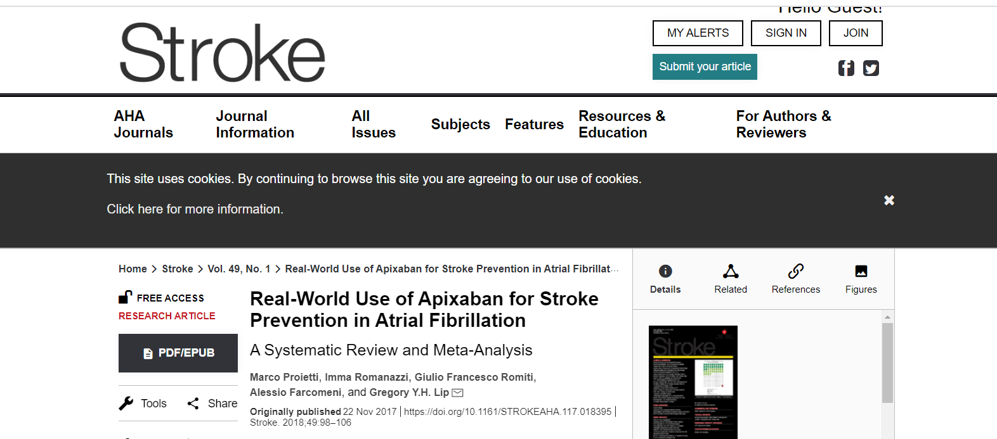
Apixaban versus other oral anticoagulants
Body

Slide 5
2018 systematic review and meta-analysis of all observational real-world of 16 studies of 170 814 patients
Compared with warfarin, apixaban regular dose was more effective in reducing any thromboembolic event (odds ratio: 0.77; 95% confidence interval: 0.64–0.93), but no significant difference was found for stroke risk.
Apixaban was as effective as dabigatran and rivaroxaban in reducing thromboembolic events and stroke.
The risk of major bleeding was significantly lower for apixaban compared with warfarin, dabigatran, and rivaroxaban (relative risk reduction, 38%, 35%, and 46%, respectively).
Similarly, the risk for intracranial hemorrhage was significantly lower for apixaban than warfarin and rivaroxaban (46% and 54%, respectively) but not dabigatran.
The risk of gastrointestinal bleeding was lower with apixaban when compared with all oral anticoagulant agents (P<0.00001 for all comparisons).

Slide 6
Conclusion

Slide 7
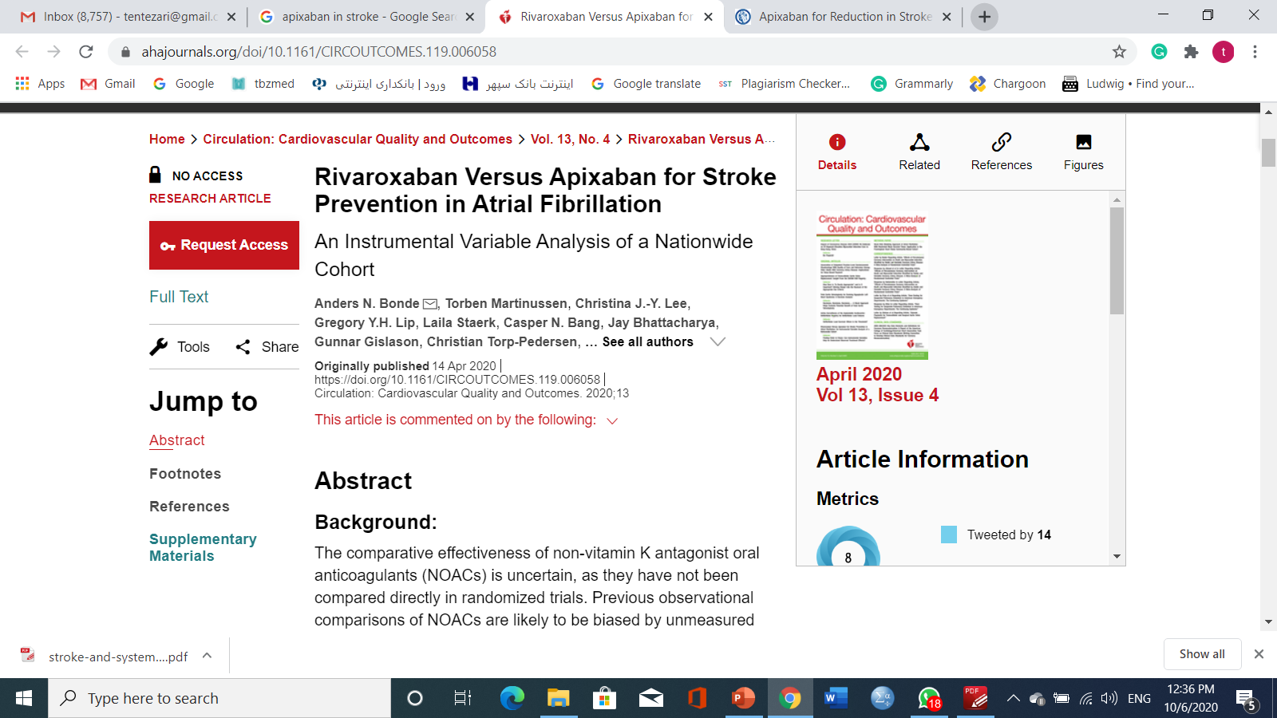

Slide 8
2020 Danish Cohort study
The occurrence of stroke/thromboembolism, major bleeding, myocardial infarction, and all-cause mortality over 2 years of follow-up were investigated using adjusted Cox regressions.
6264 Danish patients with AF initiated on rivaroxaban or apixaban.
increased risk of stroke/thromboembolism (P_{trend}=0.06)
myocardial infarction (P_{trend}=0.65)
or all-cause mortality (P_{trend}=0.89).
Adjusted Hazard Ratio 1.81 with 0% to 100% use (P_{trend}=0.01).

Slide 9
USE
Deep vein thrombosis: Treatment of deep vein thrombosis (DVT); to reduce the risk of recurrent DVT following initial therapy
Nonvalvular atrial fibrillation: To reduce the risk of stroke and systemic embolism in patients with nonvalvular atrial fibrillation (AF)
Postoperative venous thromboprophylaxis following hip or knee replacement surgery: Prophylaxis of DVT, which may lead to pulmonary embolism (PE), in patients who have undergone hip or knee replacement surgery
Pulmonary embolism: Treatment of PE; to reduce the risk of recurrent PE following initial therapy

Slide 10
Use: Off-Label
Heparin-induced thrombocytopenia (treatment); Recurrent stroke/transient ischemic attacks (prevention)

Slide 11
Contraindications
US labeling: Severe hypersensitivity reaction (ie, anaphylaxis) to apixaban or any component of the formulation; active pathological bleeding

Slide 12
Dosing in Renal Failure
Nonvalvular atrial fibrillation (to prevent stroke and systemic embolism)
Serum creatinine <1.5 mg/dL: No dosage adjustment necessary unless ≥80 years of age and body weight ≤60 kg, then reduce dose to 2.5 mg twice daily (also refer to adult dosing).
Serum creatinine ≥1.5 mg/dL and either ≥80 years of age or body weight ≤60 kg: 2.5 mg twice daily. Note: Patients with a serum creatinine >2.5 mg/dL or CrCl <25 mL/minute (as determined by Cockcroft-Gault equation) were excluded from clinical trials (Connolly 2011; Granger 2011).

Slide 13
Dose in ESRD
Severe or ESRD not requiring hemodialysis: Warfarin remains the anticoagulant of choice (AHA/ACC/HRS [January 2014]). However, in patients who cannot take warfarin, some experts consider apixaban to be a reasonable alternative (Manning 2018a).
ESRD requiring hemodialysis: According to the manufacturer, no dosage adjustment necessary unless either ≥80 years of age or body weight ≤60 kg, then reduce to 2.5 mg twice daily.

Slide 14
Dosing: Hepatic Impairment:
Mild impairment (Child-Pugh class A): No dosage adjustment required.
Moderate impairment (Child-Pugh class B): There are no dosage adjustments provided in manufacturer's labeling; use with caution (limited clinical experience in these patients).
Severe impairment (Child-Pugh class C): Use is not recommended.

Slide 15
Dosing: Obesity
The International Society on Thrombosis and Haemostasis (ISTH) 2016 guideline suggests avoiding the use of apixaban (and other direct oral anticoagulants) in patients with a BMI >40 kg/m2 or weight >120 kg due to the lack of clinical data in this population.
If used in a patient with a BMI >40 kg/m2 or weight >120 kg, ISTH suggests measuring peak and trough levels using an anti-factor Xa assay or mass spectrometry. If drug level is below the expected range, ISTH suggests changing to a vitamin K antagonist rather than adjusting the dose of apixaban (ISTH [Martin 2016]).

Slide 16
NOACs approved or under evaluation for prevention of systemic embolism or stroke in patients with non-valvular AF
 | Dabigatran | Apixaban | Edoxaban * | Rivaroxaban
Action | Direct thrombin inhibitor | Activated factor Xa (FXa) inhibitor | Activated factor Xa (FXa) inhibitor | Activated factor Xa (FXa) inhibitor
Dose | 150 mg BID 110 mg BID | 5 mg BID 2.5 mg BID | 60 mg QD 30 mg QD 15 mg QD | 20 mg QD 15 mg QD
Phase III clinical trial | RE-LY ¹ | ARISTOTLE ² AVERROES ³ | ENGAGE-AF ⁴ | ROCKET-AF ⁵
1. Connolly et al, N Engl J Med 2009; 361:1139-51 4. Ruff et al, Am Heart J 2010; 160:635-41
2. Granger et al, N Engl J Med 2011; 365:981-92 5. Patel et al, N Engl J Med 2011;365:883-91
3. Connolly et al , N Engl J Med 2011; 364:806-17

Slide 17
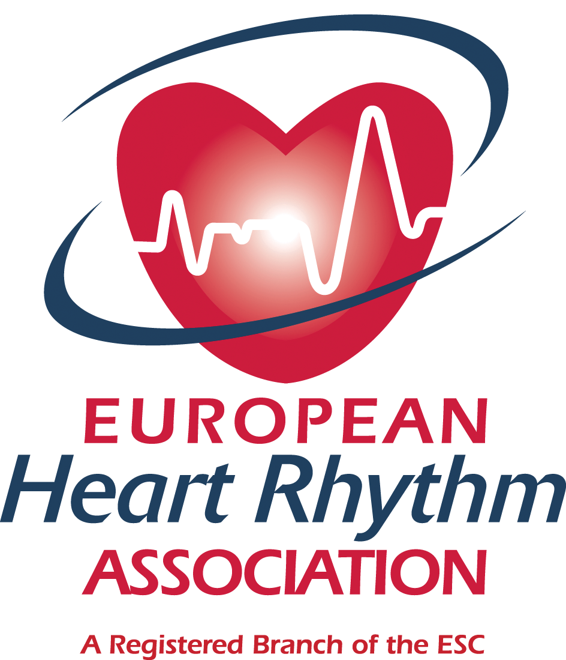
3. Drug-drug interactions and pharmacokinetics of NOACs Absorption and metabolism of NOACs
www.escardio.org/EHRA

Slide 18
Absorption and metabolism of NOAC
 | Dabigatran | Apixaban | Edoxaban * | Rivaroxaban
Bioavailability | 3-7% | 50% | 62% | 66% (w/o food) ~100% with food
Prodrug | yes | no | no | no
Clearance: non-renal/renal of adsorbed dose if normal renal function | 20%/80% | 73%/27% | 50%/50% | 65%/35%
Liver metabolism: CYP3A4 | no | yes (elimination; minor CYP3A4) | minimal (<4% of elimination) | yes (elimination)
Absorption with food | no effect | no effect | 6-22% more | +39%
Intake with food? | no | no | no official recommendation yet | mandatory
Absorption with H2B/PPI | plasma level -12 to -30% | no effect | no effect | no effect
Asian ethnicity | plasma level +25% | no effect | no effect | no effect
GI tolerability | dyspepsia 5-10% | no problem | no problem | no problem
Elimination half-life | 12-17h | 12h | 9-11h | 5-9h (young)/11-13h (elderly)
* not approved yet
www.escardio.org/EHRA

Slide 19
Possible drug-drug interactions – Effect on NOAC plasma levels part 1
 |  | Dabigatran | Apixaban | Edoxaban | Rivaroxaban
Atorvastatin | P-gp/ CYP3A4 | +18% | no data yet | no effect | no effect
Digoxin | P-gp | no effect | no data yet | no effect | no effect
Verapamil | P-gp/ wk CYP3A4 | +12–180% | no data yet | + 53% (slow release) | minor effect
Diltiazem | P-gp/ wk CYP3A4 | no effect | +40% | No data | minor effect
Quinidine | P-gp | +50% | no data yet | +80% | +50%
Amiodarone | P-gp | +12–60% | no data yet | no effect | minor effect
Dronedarone | P-gp/CYP3A4 | +70–100% | no data yet | +85% | no data yet
Ketoconazole; itraconazole; voriconazole; posaconazole; | P-gp and BCRP/ CYP3A4 | +140–150% | +100% | no data yet | up to +160%
Red – contraindicated; orange – reduce dose; yellow – consider dose reduction if another yellow factor present;
hatching – no data available; recommendation made from pharmacokinetic considerations
www.escardio.org/EHRA

Slide 20
Possible drug-drug interactions – Effect on NOAC plasma levels part 2
 | Interaction | Dabigatran | Apixaban | Edoxaban | Rivaroxaban
Fluconazole | CYP3A4 | no data | no data | no data | +42%
Cyclosporin; tacrolimus | P-gp | no data | no data | no data | +50%
Clarithromycin; erythromycin | P-gp/ CYP3A4 | +15–20% | no data | no data | +30–54%
HIV protease inhibitors | P-gp and BCRP/ CYP3A4 | no data | strong increase | no data | up to +153%
Rifampicin; St John’s wort; carbamezepine; phenytoin; phenobarbital | P-gp and BCRP/ CYP3A4/CYP2J2 | -66% | -54% | -35% | up to -50%
Antacids | GI absorption | -12-30% | no data | no effect | no effect
Red – contraindicated; orange – reduce dose; yellow – consider dose reduction if another yellow factor present;
hatching – no data available; recommendation made from pharmacokinetic considerations
www.escardio.org/EHRA

Slide 21
NOACs in renal dysfunction – Practical recommendations for dosing in chronic kidney disease
Dabigatran | Apixaban | Edoxaban * | Rivaroxaban
When CrCl 30-49 ml/min, 150 mg BID is possible (SmPC) but 110 mg BID if ‘high risk of bleeding’ (SmPC) or ‘recommended’ (GL update)¹ Note: 75 mg BID approved in US only ** if CrCl 15-30 ml/min - if CrCl 30-49 ml/min and other orange factor (e.g. verapamil) | CrCl 15-29 ml/min: 2.5 mg BID is possible Serum creatinine ≥ 1.5 mg/dl in combination with age ≥80 years or weight ≤60 kg (SmPC) or with other yellow’ factor: 2.5 mg BID | not available | 15 mg OD when CrCl 15-49 ml/min
* No EMA approval yet. Needs update after finalisation of SmPC ** No EMA indication. FDA recommendation based on pharmacokinetics. Carefully consider benefits and risks of this approach Note that 75 mg capsules are not available in Europe for AF indication.
1. Camm et al, Eur Heart J 2012;33:2719-47
www.escardio.org/EHRA

Slide 22
Thanks for your attention

